Slide 1
Automated Real-Time Expense Tracker using Flutter and Linear Regression
Submitted by : Meenavarsni.M
Roll No : 2028MCA0020
Register No : 67220200042
Under the guidance of – DR. K. Murugan

Slide 2
Abstract
For the past 5 years, online transactions and digital payments have become very common in our country (India) and at this point even small scale businesses accept payments through UPI apps. That’s the impact of digital payments in our country. Since it’s become very convenient to make payments even as low as ten rupees with the click of a single button, it has become quite difficult to control expenses and keep track of them. The goal of this project is to create an expense tracking application with a feature that allow users to set a spending limit above which, if the user spends, the user will get an alert notification. The additional feature is that to analyze the transactions made and to predict the user’s future expenses using Machine Learning. Most importantly, the app would function perfectly even when the app is closed and is running in the background. The additional features would be a great addition to the already existing features for expense tracking applications. This is the Expense Tracking Application (SpenTrak) that is built using the flutter and the Google’s Firebase platform.

Slide 3
Existing System
Most of the existing expense tracking apps doesn’t automatically detect expenses that are made but they need to be entered manually.
Even if the apps can detect the expenses from text messages it doesn’t happen in real-time so the need for the app to perform in the background is necessary.
The use and need for machine learning to predict data is highlighted.
Also, the working and existing types of expense tracking apps that are talked about helps to narrow down to what kind of platform and APIs that are required for this project.
By using less complex methods, a different and relatively more efficient system of using apps in general can be achieved.
The use of platforms like Firebase and flutter allows for the easy creation of various apps and medium to test ideas. These ideas can then also be taken public using the platforms.

Slide 4
Objectives of the Proposed Work
The primary objective is to create a full-stack mobile application that detects the mobile's incoming SMS in real time and filters the text messages that are related to the UPI transactions.
The secondary objective is to use the data that is retrieved to track the expenses in order to generate the statistical analysis and alert the users if they have exceeded their spending limit.
The last objective is to predict a pattern from the user's previous spending pattern and generate a predictive analysis using ML.

Slide 5
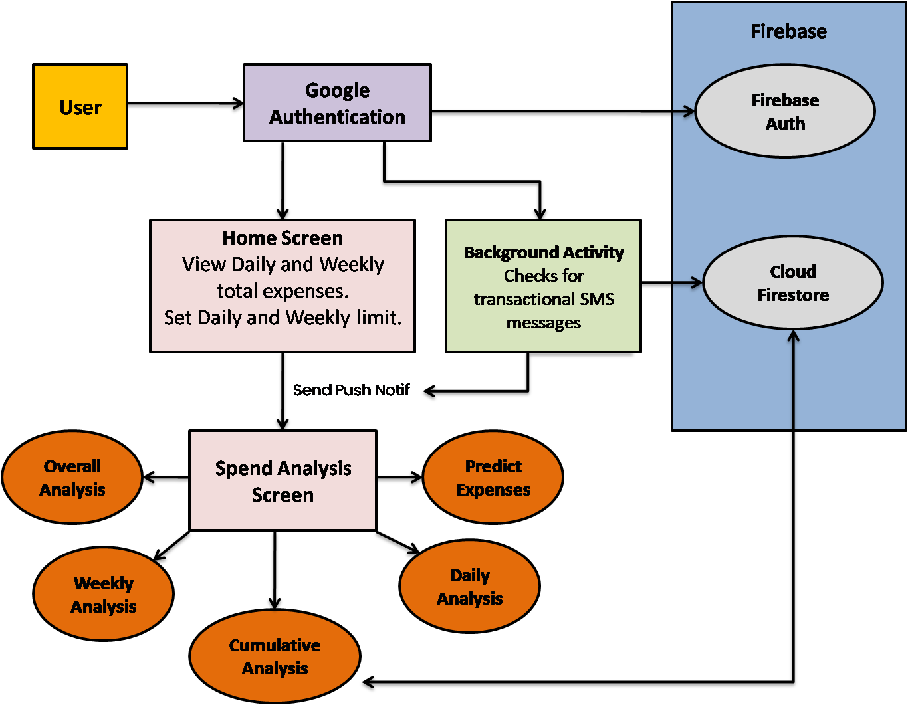
System Architecture

Slide 6
Proposed Method
A background process is a computer process that runs behind the scenes and without user intervention. To implement the first objective, the foreground and background services should be enabled in the mobile app where it is developed. Only then the app would be able to retrieve the incoming SMS messages that the user's device would receive over every digital transaction. The Telephony package in flutter enables the app to listen to the incoming SMS messages that could be filtered further to retrieve only the messages which contain the receipts of the digital transactions.

Slide 7
With the first objective implemented, now store the data has to be stored in Firestore, which is an open-source platform provided by the Google. To predict the future expenses, the linear regression algorithm is tentatively used to predict how much amount the user might spend in the next day or week.
The user needs to set a spend limit once the user creates an account. After that when the user makes a payment, the telephony package retrieves the message. This is where a conditional statement is created to check if the total amount spent on that particular day or week exceeds the limit set by the user. If it does then the app would send the user a push-notification in real-time.

Slide 8
Software Requirements
Flutter
Visual Studio Code (Any IDE)
Android Studio
A registered Google Account
A Firebase account to manage your Console
Java SE Development kit (version 8 or above)
A mobile device to test with the developer option enabled
Git

Slide 9
Dependencies Used
cupertino_icons
telephony
google_sign_in
cloud_firestore
uuid
flutter_local_notifications
flutter_background
fl_chart
charts_flutter

Slide 10
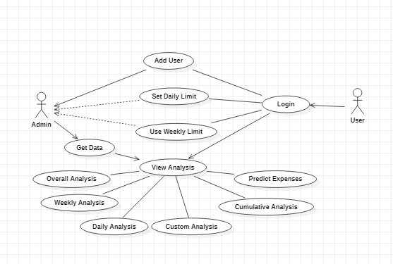
Use Case Diagram

Slide 11
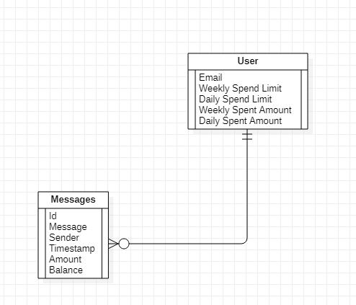
ER Diagram

Slide 12
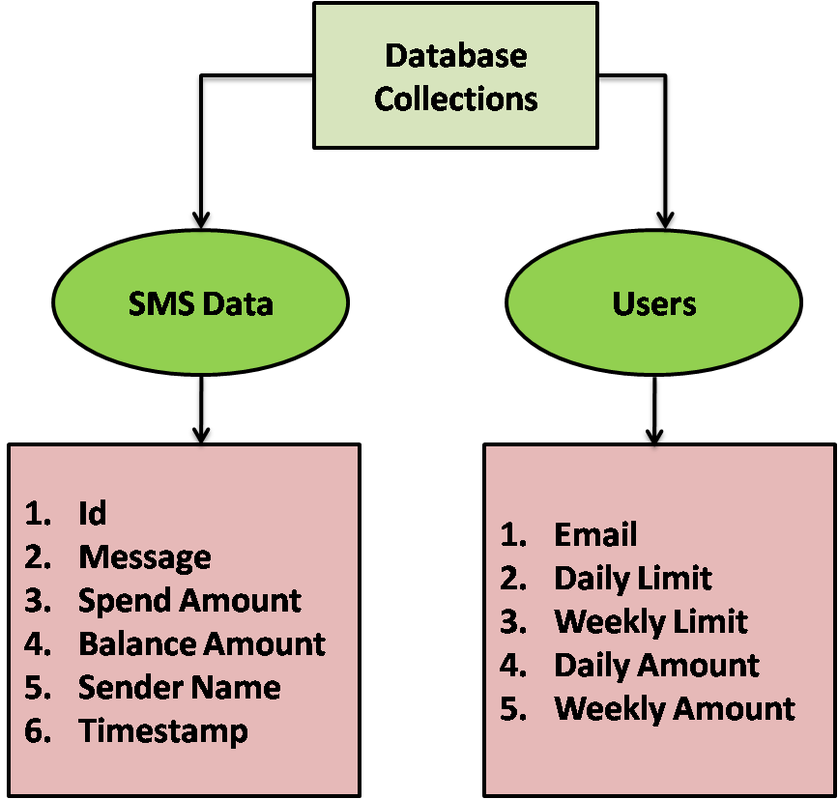
Database Table design

Slide 13
Data Set
A few of the training data for the possible transactional messages are as follows:
An amount of INR 220.00 has been DEBITED to your account XXXX4230 on 30/11/2022. Total Avail.bal INR 50.25. - Canara Bank
Your LVB a/c no. XXXXXXXXXXXX2319 is debited for Rs.5460.0 on 01-12-22 (UPI Ref no 233501822886).
Dear SBI User, your A/c X8298-debited by Rs3000.0 on 28Nov22 transfer to Ms Linda Dharmaraj Ref No 233233440339. If not done by u, fwd this SMS to 9223008333/Call 1800111109 or 09449112211 to block UPI –SBI
Your VPA muthunagappan@paytm linked to Indian Bank a/c no. XXXXXX0504 is debited for Rs.1000.00 and credited to 918428835116@PYTM0123456.ifsc.npci (UPI Ref no 230979553607).-Indian Bank
Your a/c XXXXXXXXXX5124 debited for payee MADESWARAN S for Rs. 1.00 on 2022-12-01, ref 233527885659.If not you, report to your bank immediately-IOB.

Slide 14
SMS Extraction
The SMS that we need to retrieve would be in this format and none of the values will be same all the time whether it’s the spent amount, or the recipient UPI ID or the balance amount or even the bank name because different users would be using different bank accounts. So, the one thing that’s common is the key phrase – “is debited from”. So, from the above message, the spent amount would be extracted in the following way:
Your a/c XXXXXXXXXX5124 debited for payee MADESWARAN S for Rs. 1.00 on 2022-12-01, ref 233527885659.If not you, report to your bank immediately-IOB.

Slide 15
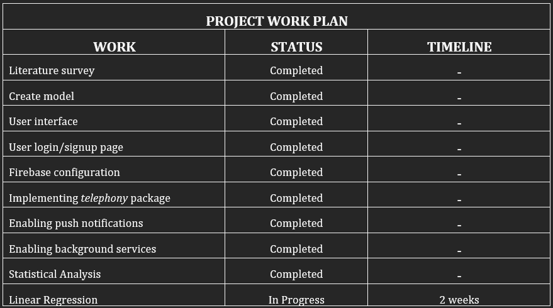
Work Plan

Slide 16
Work Completed
Researched existing apps and research papers to understand the available technology and to develop new ideas.
Created Architecture flow of the app, deciding on using flutter for frontend and firebase for backend.
User login/signup page UI design is completed.
Firebase configuration for authentication and database is completed.
Implemented telephony package to get the SMS received related to UPI transactions.
Triggered the notification services if the SMS indicates if the user has exceeded the spending limit.
Enabled background services to listen to incoming text messages even when the app is not running.
Produced a graphical analysis and a statistical chart after analyzing the expenses the user makes on an overall, daily and weekly basis.

Slide 17
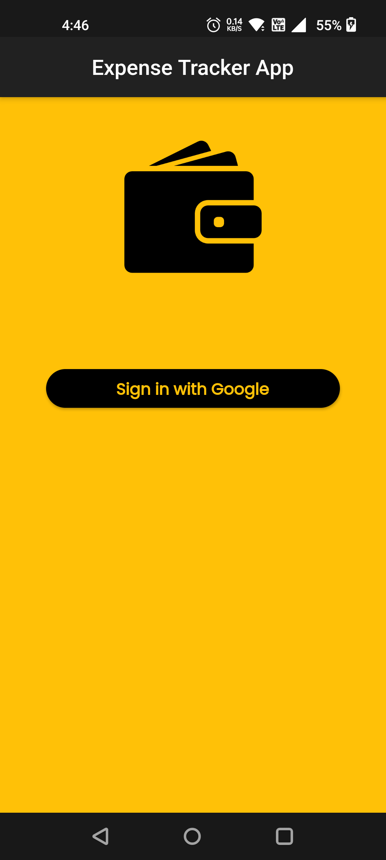
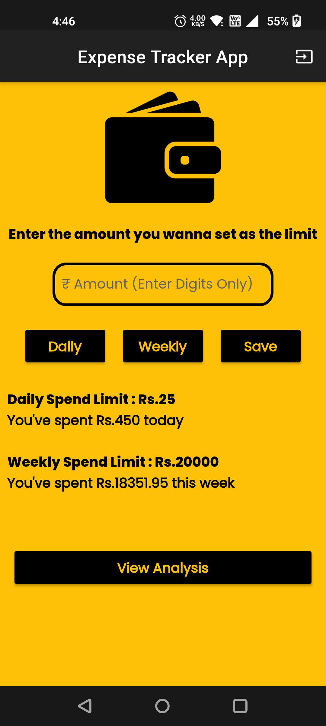
Work Completed
Fig: Home Screen
Fig: Dashboard

Slide 18
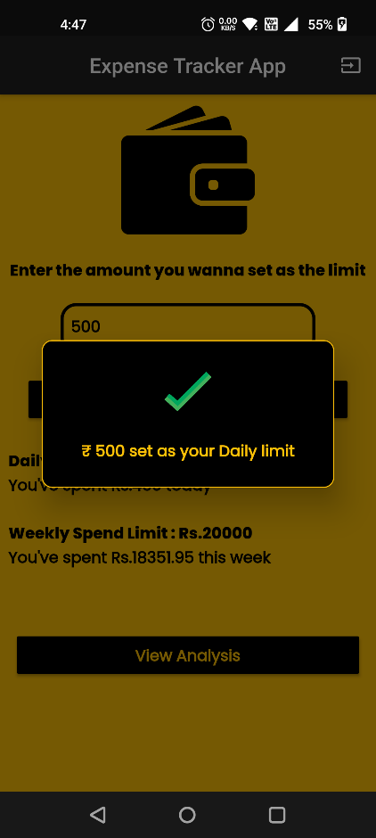
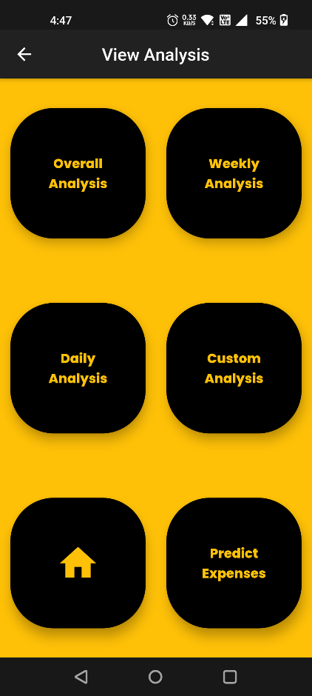
Work Completed
Fig: Pop-up Alert
Fig: Expense Analysis

Slide 19
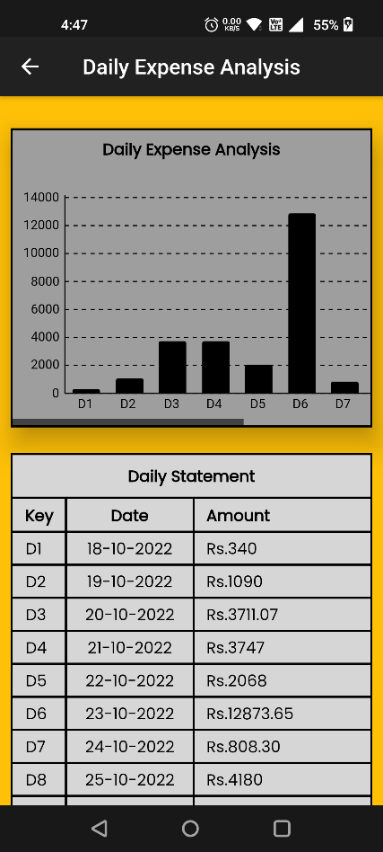
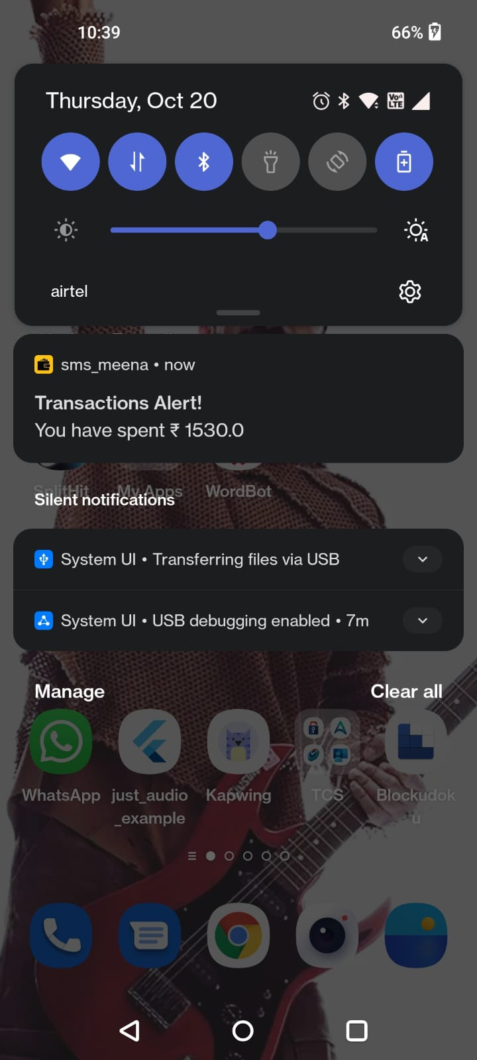
Work Completed
Fig: Daily Expense Analysis
Fig: Transaction Alert

Slide 20
Works To be Done
The third phase of this project is to implement an ML algorithm to predict the user’s spending pattern and predict the user’s future expenses.
The predicting pattern that seemed apt for this problem statement is Linear Regression.
The algorithm has been designed. The implementation part is a work in progress.

Slide 21
References
[1] Adepegba, O. A., Fayemiwo, M.A., Oduwole, O. A. & Onamade A. A, “An Android Based Mobile Application for Tracking Daily Expenses” at Global Ecosystem for Nurturing Multidisciplinary Research Innovations, January 2019, pp.97-112.
[2] Velmurugan A, Albert Mayan J, Niranjana P & Richard Francis, “Expense Manager Application” at Journal of Physics Conference Series 1712(1):012039, December 2020, pp.1-8.
[3] Prof Miriam Thomas, Lekshmi P, & Dr.Mahalekshmi T, "Expense Tracker", International Journal of Advanced Research in Science, Communication and Technology (IJARSCT), September 2020, pp.5-9.
[4] Uday Pratap Singh, Aakash Kumar Gupta & Dr B. Balamurugan, "Spending Tracker: A Smart Approach to Track Daily", Turkish Journal of Computer and Mathematics Education, April 2021, pp.5095-5103.
[5] Angad Manchanda of San Diego State University, “EXPENSE TRACKER MOBILE APPLICATION”, A Thesis Presented to the Faculty of San Diego State University, December 2012, pp.1-70.
[6] Li Lyna Zhang, Chieh-Jan Mike Liang, Yunxin Liu & Enhong Chen, “Systematically Testing Background Services of Mobile Apps”, ASE 2017, Urbana-Champaign, IL, USA Technical Research, IEEE 2017, pp.4-15.
[7] Ademola O. Adesina, Kehinde K. Agbele, Ademola P. Abidoye & Henry O. Nyongesa, “Text messaging and retrieval techniques for a mobile health information system”, Journal of Information Science 40(6):736-748, December 2014, pp.1-13.
[8] Akshay Jadhav, Avinash Chaudhary, Vikrant Hande & Mahi Khemchandani, “Android App for Retrieve Mobile Contacts, SMS, Unread Calls”, International Journal for Research in Engineering Application & Management (IJREAM) ISSN : 2494-9150 Vol-01, Issue 10, January 2016, pp.1-6.
[9] Khushbu Kumari, Suniti Yadav, “Linear Regression Analysis Study”, Journal of the Practice of Cardiovascular Sciences Vol-04, Issue 1, May 2018, pp.33-36.
[10] Mathias Holm, “Machine learning and spending patterns - A study on the possibility of identifying riskily spending behaviour”, December 2017, pp.1-82.

